Slide 1

UBER DATA ANALYSIS

Slide 2
Problem Statement:
We have given data set of uber cars, we face problem of cancellation car by the driver or non-availability of cars.
Well, if these are the problems faced by customers, these very issues also impact the business of Uber. If drivers cancel the request of riders or if cars are unavailable, Uber loses out on its revenue.
Let's try to resolve all problems like this by analyzing the data set.

Slide 3
Analysis:
For a basic start I have imported my data and required libraries.
Then I have get a deep look into a data, I found that dataset was not perfect and has null values etc.
For a next step I cleaned my data using pandas , I replaced null values
Then I Merage and Manipulated data as per my conclusion and observation.
After doing all the manipulation, I got the data, I desired then I have plots some graph using matplotlib library.
You can see all graphs and all plots in next slide.

Slide 4
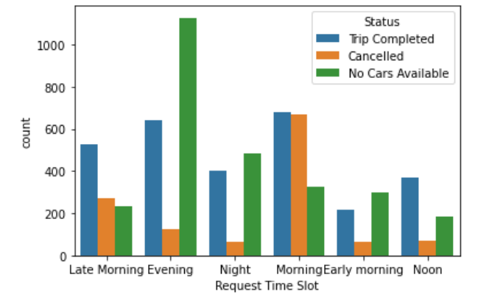
Graphs:
Observation:
Conclusions from Following plot:
Most No Cars Available are in the Evening.
Most Cancelled trips are in the Morning.

Slide 5
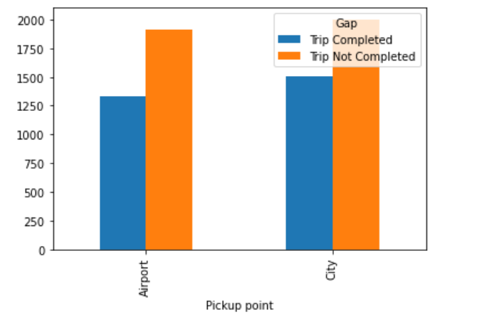
Observation:
Here I display the plot to count the number of requests that was completed and which was not , against pickup point.
In the following Graph we can conclude that, The rate of Trip completed is less than the rate of trip is not completed in both Area.

Slide 6
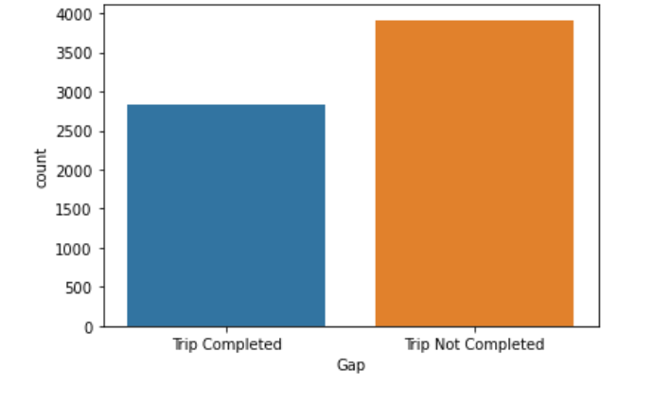
Observation:
Here I display Plot to count number of Request that was completed and which is not.
In the following plot I have concluded that the rate of 'Trip completed' is less than 'Trip not completed’.
Or we have to use Bar plot Because it’s help me to easy or understandable Analysis.

Slide 7
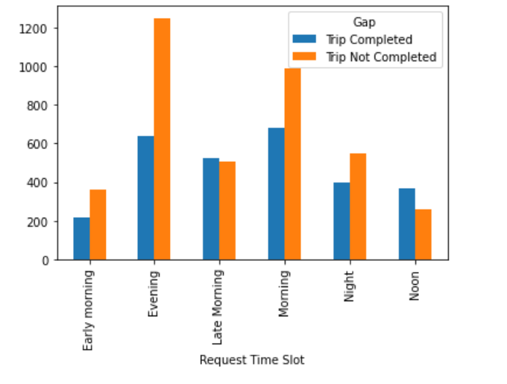
Observation:
In this graph, we can conclude that the rate of trip completed is high in the morning.
As well as the of trip not completed is high in the Evening.
Ratio of 'Trip completed' and 'Trip Not completed' are same in Late morning.

Slide 8
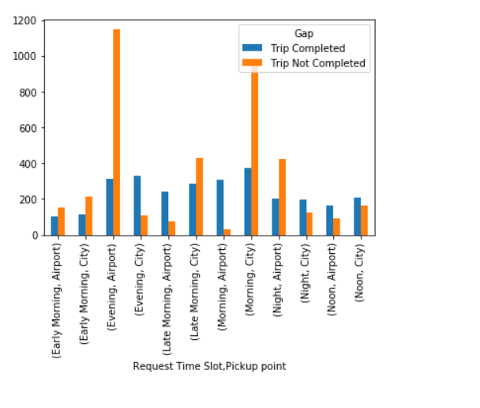
Observation:
Plot to count the number of requests that was completed and which was not, for the final analysis.

Slide 9
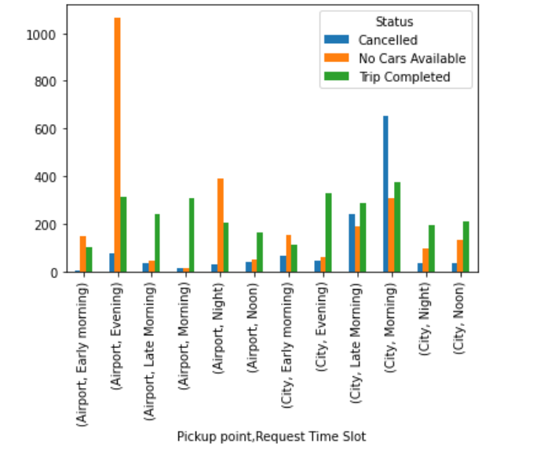
Demand:
In this graph, I have grouped data on Pickup point , Request Time Slot, Status and plot the graph that if car is available near to city or airport.
I have concluded that the cars are not available near to airport at evening time.
Low cancellation rate of cars near airport at early morning.
High cancellation rate of cars in city at morning.
Rate of High Trip completed is in the city at morning.
Rate of Low Trip completed is near to airport at Early Morning, as well as In the city at Early morning.

Slide 10
Recommendation:
Based on the data analysis performed, following recommendation can be used by uber to bridge the gap between supply and demand:
For bridging the demand supply gap from airport to city, making a permanent stand in the airport itself where the cabs will be available at all times and the incomplete requests can come down significantly.
Uber can provide some incentives to the driver who complete the trip from city to airport in the morning part. This might result the driver to not cancel the request from the city airport trips.
Last but sure solution to bring down the gap is to increase the numbers of cab in its fleet.

